Slide 1
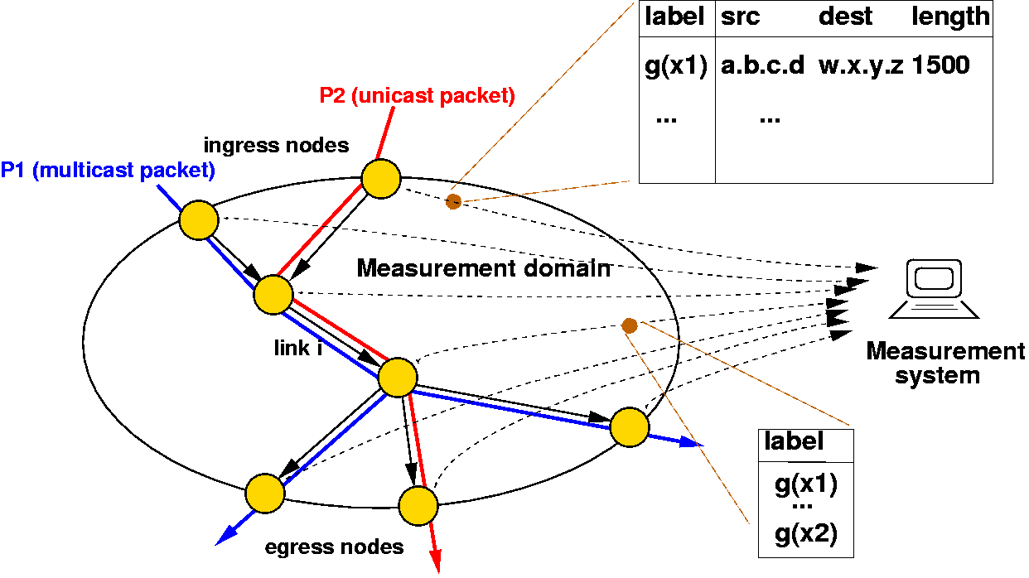
Sampling for Big Data
x₁₀
x’₁₀
x₉
x’₉
∅
x₈
x’₈
x₇
x’₆
0
1
x₆
x’₅
x₅
x’₄
x₄
x’₃
00
01
10
11
x₃
x’₂
x₂
000
001
010
011
100
101
110
111
x₁
x’₁
Graham Cormode, University of Warwick G.Cormode@warwick.ac.uk
Nick Duffield, Texas A&M University Nick.Duffield@gmail.com

Slide 2
Data Scale: Hashing and Coordination

Slide 3
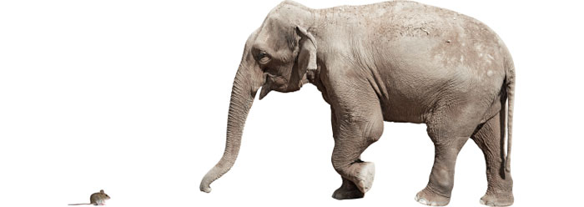
Sampling from the set of items
Sometimes need to sample from the distinct set of objects
Not influenced by the weight or number of occurrences
E.g. sample from the distinct set of flows, regardless of weight
Need sampling method that is invariant to duplicates
Basic idea: build a function to determine what to sample
A “random” function f(k) → R
Use f(k) to make a sampling decision: consistent decision for same key

Slide 4
Permanent Random Numbers
Often convenient to think of f as giving “permanent random numbers”
Permanent: assigned once and for all
Random: treat as if fully randomly chosen
The permanent random number is used in multiple sampling steps
Same “random” number each time, so consistent (correlated) decisions
Example: use PRNs to draw a sample of s from N via order sampling
If s << N, small chance of seeing same element in different samples
Via PRN, stronger chance of seeing same element
Can track properties over time, gives a form of stability
Easiest way to generate PRNs: apply a hash function to the element id
Ensures PRN can be generated with minimal coordination
Explicitly storing a random number for all observed keys does not scale

Slide 5
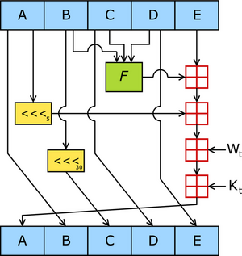
Hash Functions
Many possible choices of hashing functions:
Cryptographic hash functions: SHA-1, MD5, etc.
Results appear “random” for most tests (using seed/salt)
Can be slow for high speed/high volume applications
Full power of cryptographic security not needed for most statistical purposes
Although possible some trade-offs in robustness to subversion if not used
Heuristic hash functions: srand(), mod
Usually pretty fast
May not be random enough: structure in keys may cause collisions
Mathematical hash functions: universal hashing, k-wise hashing
Have precise mathematical properties on probabilities
Can be implemented to be very fast

Slide 6
Mathematical Hashing
K-wise independence: Pr[h(x₁) = y₁ ∧ h(x₂) = y₂ ∧ … ∧ h(x_{t}) = y_{t}] = 1/R^{t}
Simple function: c_{t}x^{t} + c_{t-1}x^{t-1} + … c₁x + c₀ mod P
For fixed prime P, randomly chosen c₀ … c_{t}
Can be made very fast (choose P to be Mersenne prime to simplify mods)
(Twisted) tabulation hashing [Thorup Patrascu 13]
Interpret each key as a sequence of short characters, e.g. 8 * 8bits
Use a “truly random” look-up table for each character (so 8 * 256 entries)
Take the exclusive-OR of the relevant table values
Fast, and fairly compact
Strong enough for many applications of hashing (hash tables etc.)

Slide 7
Bottom-k sampling
0.391
0.908
0.291
0.391
0.391
0.273
Sample from the set of distinct keys
Hash each key using appropriate hash function
Keep information on the keys with the s smallest hash values
Think of as order sampling with PRNs…
Useful for estimating properties of the support set of keys
Evaluate any predicate on the sampled set of keys
Same concept, several different names:
Bottom-k sampling, Min-wise hashing, K-minimum values

Slide 8
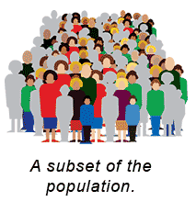
Subset Size Estimation from Bottom-k
Want to estimate the fraction t = |A|/|D|
D is the observed set of data
A is an arbitrary subset given later
E.g. fraction of customers who are sports fans from midwest aged 18-35
Simple algorithm:
Run bottom-k to get sample set S, estimate t’ = |A ∩ S|/s
Error decreases as 1/√s
Analysis due to [Thorup 13]: simple hash functions suffice for big enough s

Slide 9
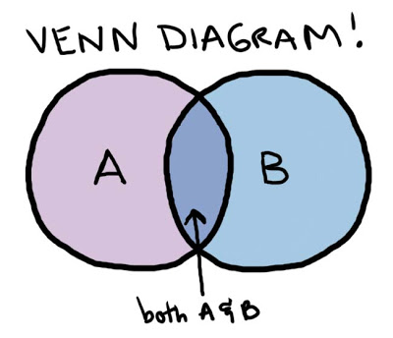
Similarity Estimation
How similar are two sets, A and B?
Jaccard coefficient: |A ∩ B|/|A ∪ B|
1 if A, B identical, 0 if they are disjoint
Widely used, e.g. to measure document similarity
Simple approach: sample an item uniformly from A and B
Probability of seeing same item from both: |A ∩ B|/(|A| × |B|)
Chance of seeing same item too low to be informative
Coordinated sampling: use same hash function to sample from A, B
Probability that same item sampled: |A ∩ B|/|A ∪ B|
Repeat: the average number of agreements gives Jaccard coefficient
Concentration: (additive) error scales as 1/√s

Slide 10
Technical Issue: Min-wise hashing
For analysis to work, the hash function must be fully random
All possibly permutations of the input are equally likely
Unrealistic in practice: description of such a function is huge
“Simple” hash functions don’t work well
Universal hash functions are too skewed
Need hash functions that are “approximately min-wise”
Probability of sampling a subset is almost uniform
Tabulation hashing a simple way to achieve this

Slide 11
Bottom-k hashing for F₀ Estimation
F₀ is the number of distinct items in the stream
a fundamental quantity with many applications
E.g. number of distinct flows seen on a backbone link
Let m be the domain of stream elements: each data item is [1…m]
Pick a random (pairwise) hash function h: [m] → [R]
Apply bottom-k sampling under hash function h
Let v_{s} = s’th smallest (distinct) value of h(i) seen
If n = F₀ < s, give exact answer, else estimate F’₀ = sR/v_{s}
v_{s}/R ≈ fraction of hash domain occupied by s smallest
0R
v_{s}
R

Slide 12
Analysis of F₀ algorithm
Can show that it is unlikely to have an overestimate
Too many items hashed below a fixed value
Can treat each event of an item hashing too low as independent
Similar outline to show unlikely to have an overestimate
(Relative) error scales as 1/√s
Space cost:
Store s hash values, so O(s log m) bits
Can improve to O(s + log m) with additional hashing tricks
See also “Streamed Approximate Counting of Distinct Elements”, KDD’14
0R
v_{s}
sR/(1+ε)n
R

Slide 13
Consistent Weighted Sampling
Want to extend bottom-k results when data has weights
Specifically, two data sets A and B where each element has weight
Weights are aggregated: we see whole weight of element together
Weighted Jaccard: want probability that same key is chosen by both to be ∑_{i} min(A(i), B(i))/∑_{i} max(A(i), B(i))
Sampling method should obey uniformity and consistency
Uniformity: element i picked from A with probability proportional to A(i)
Consistency: if i is picked from A, and B(i) > A(i), then i also picked for B
Simple solution: assuming integer weights, treat weight A(i) as A(i) unique (different) copies of element i, apply bottom-k
Limitations: slow, unscalable when weights can be large
Need to rescale fractional weights to integral multiples

Slide 14
Consistent Weighted Sampling
Efficient sampling distributions exist achieving uniformity and consistency
Basic idea: consider a weight w as w/Δ different elements
Compute the probability that any of these achieves the minimum value
Study the limiting distribution as Δ → 0
Consistent Weighted Sampling [Manasse, McSherry, Talway 07], [Ioffe 10]
Use hash of item to determine which points sampled via careful transform
Many details needed to contain bit-precision, allow fast computation
Other combinations of key weights are possible [Cohen Kaplan Sen 09]
Min of weights, max of weights, sum of (absolute) differences

Slide 15
Trajectory Sampling
Aims [Duffield Grossglauser 01]:
Probe packets at each router they traverse
Collate reports to infer link loss and latency
Need to sample; independent sampling no use
Hash-based sampling:
All routers/packets: compute hash h of invariant packet fields
Sample if h ∈ some H and report to collector; tune sample rate with |H|
Use high entropy packet fields as hash input, e.g. IP addresses, ID field
Hash function choice trade-off between speed, uniformity & security
Standardized in Internet Engineering Task Force (IETF)
Service providers need consistency across different vendors
Several hash functions standardized, extensible
Same issues arise in other big data ecosystems (apps and APIs)

Slide 16
Hash Sampling in Network Management
Many different network subsystems used to provide service
Monitored through event logs, passive measurement of traffic & protocols
Need cross-system sample that captures full interaction between network and a representative set of users
Ideal: hash-based selection based on common identifier
Administrative challenges! Organizational diversity
Timeliness challenge:
Selection identifier may not be present at a measurement location
Example: common identifier = anonymized customer id
Passive traffic measurement based on IP address
Mapping of IP address to customer ID not available remotely
Attribution of traffic IP address to a user difficult to compute at line speed

Slide 17
Advanced Sampling from Sketches
Difficult case: inputs with positive and negative weights
Want to sample based on the overall frequency distribution
Sample from support set of n possible items
Sample proportional to (absolute) total weights
Sample proportional to some function of weights
How to do this sampling effectively?
Challenge: may be many elements with positive and negative weights
Aggregate weights may end up zero: how to find the non-zero weights?
Recent approach: L₀ sampling
L₀ sampling enables novel “graph sketching” techniques
Sketches for connectivity, sparsifiers [Ahn, Guha, McGregor 12]

Slide 18
L₀ Sampling
L₀ sampling: sample with prob ≈ f_{i}⁰/F₀
i.e., sample (near) uniformly from items with non-zero frequency
General approach: [Frahling, Indyk, Sohler 05, C., Muthu, Rozenbaum 05]
Sub-sample all items (present or not) with probability p
Generate a sub-sampled vector of frequencies f_{p}
Feed f_{p} to a k-sparse recovery data structure
Allows reconstruction of f_{p} if F₀ < k
If f_{p} is k-sparse, sample from reconstructed vector
Repeat in parallel for exponentially shrinking values of p

Slide 19
Sampling Process
p=1/U
k-sparse recovery
p=1
Exponential set of probabilities, p=1, ½, ¼, 1/8, 1/16… 1/U
Let N = F₀ = |{ i : f_{i} ≠ 0}|
Want there to be a level where k-sparse recovery will succeed
At level p, expected number of items selected S is Np
Pick level p so that k/3 < Np ≤ 2k/3
Chernoff bound: with probability exponential in k, 1 ≤ S ≤ k
Pick k = O(log 1/δ) to get 1-δ probability

Slide 20
Hash-based sampling summary
Use hash functions for sampling where some consistency is needed
Consistency over repeated keys
Consistency over distributed observations
Hash functions have duality of random and fixed
Treat as random for statistical analysis
Treat as fixed for giving consistency properties
Can become quite complex and subtle
Complex sampling distributions for consistent weighted sampling
Tricky combination of algorithms for L₀ sampling
Plenty of scope for new hashing-based sampling methods

Slide 21
Data Scale: Massive Graph Sampling

Slide 22





Massive Graph Sampling
“Graph Service Providers”
Search providers: web graphs (billions of pages indexed)
Online social networks
Facebook: ~10⁹ users (nodes), ~10¹² links
ISPs: communications graphs
From flow records: node = src or dst IP, edge if traffic flows between them
Graph service provider perspective
Already have all the data, but how to use it?
Want a general purpose sample that can:
Quickly provide answers to exploratory queries
Compactly archive snapshots for retrospective queries & baselining
Graph consumer perspective
Want to obtain a realistic subgraph directly or via crawling/API

Slide 23
Retrospective analysis of ISP graphs
Node = IP address
Directed edge = flow from source node to destination node
compromise
control
flooding
Hard to detect against background
Known attacks can be detected:
Signature matching based on partial graphs, flow features, timing
Unknown attacks are harder to spot:
exploratory & retrospective analysis
preserve accuracy if sampling?
BOTNET

Slide 24
Goals for Graph Sampling
Crudely divide into three classes of goal:
Study local (node or edge) properties
Average age of users (nodes), average length of conversation (edges)
Estimate global properties or parameters of the network
Average degree, shortest path distribution
Sample a “representative” subgraph
Test new algorithms and learning more quickly than on full graph
Challenges: what properties should the sample preserve?
The notion of “representative” is very subjective
Can list properties that should be preserved (e.g. degree dbn, path length dbn), but there are always more…

Slide 25
Models for Graph Sampling
Many possible models, but reduce to two for simplicity
(see tutorial by Hasan, Ahmed, Neville, Kompella in KDD 13)
Static model: full access to the graph to draw the sample
The (massive) graph is accessible in full to make the small sample
Streaming model: edges arrive in some arbitrary order
Must make sampling decisions on the fly
Other graph models capture different access scenarios
Crawling model: e.g. exploring the (deep) web, API gives node neighbours
Adjacency list streaming: see all neighbours of a node together

Slide 26
Node and Edge Properties
Gross over-generalization: node and edge properties can be solved using previous techniques
Sample nodes/edge (in a stream)
Handle duplicates (same edge many times) via hash-based sampling
Track properties of sampled elements
E.g. count the degree of sampled nodes
Some challenges. E.g. how to sample a node proportional to its degree?
If degree is known (precomputed), then use these as weights
Else, sample edges uniformly, then sample each end with probability ½

Slide 27
Induced subgraph sampling
Node-induced subgraph
Pass 1: Sample a set of nodes (e.g. uniformly)
Pass 2: collect all edges incident on sampled nodes
Can collapse into a single streaming pass
Can’t know in advance how many edges will be sampled
Edge-induced subgraph
Sample a set of edges (e.g. uniformly in one pass)
Resulting graph tends to be sparse, disconnected
Edge-induced variant [Ahmed Neville Kompella 13]:
Take second pass to fill in edges on sampled nodes
Hack: combine passes to fill in edges on current sample

Slide 28
HT Estimators for Graphs
Can construct HT estimators from uniform vertex samples [Frank 78]
Evaluate the desired function on the sampled graph (e.g. average degree)
For functions of edges (e.g. number of edges satisfying a property):
Scale up accordingly, by N(N-1)/(k(k-1)) for sample size k on graph size N
Variance of estimates can also be bounded in terms of N and k
Similar for functions of three edges (triangles) and higher:
Scale up by NC3/kC3 ≈ 1/p³ to get unbiased estimator
High variance, so other sampling schemes have been developed

Slide 29
Graph Sampling Heuristics
“Heuristics”, since few formal statistical properties are known
Breadth first sampling: sample a node, then its neighbours…
Biased towards high-degree nodes (more chances to reach them)
Snowball sampling: generalize BF by picking many initial nodes
Respondent-driven sampling: weight the snowball sample to give statistically sound estimates [Salganik Heckathorn 04]
Forest-fire sampling: generalize BF by picking only a fraction of neighbours to explore [Leskovec Kleinberg Faloutsos 05]
With probability p, move to a new node and “kill” current node
No “one true graph sampling method”
Experiments show different preferences, depending on graph and metric [Leskovec, Faloutsos 06; Hasan, Ahmed, Neville, Kompella 13]
None of these methods are “streaming friendly”: require static graph
Hack: apply them to the stream of edges as-is

Slide 30
Random Walks Sampling
Random walks have proven very effective for many graph computations
PageRank for node importance, and many variations
Random walk a natural model for sampling a node
Perform “long enough” random walk to pick a node
How long is “long enough” (for mixing of RW)?
Can get “stuck” in a subgraph if graph not well-connected
Costly to perform multiple random walks
Highly non-streaming friendly, but suits graph crawling
Multidimensional Random Walks [Ribeiro, Towsley 10]
Pick k random nodes to initialize the sample
Pick a random edge from the union of edges incident on the sample
Can be viewed as a walk on a high-dimensional extension of the graph
Outperforms running k independent random walks

Slide 31
Subgraph estimation: counting triangles
Hot topic: sample-based triangle counting
Triangles: simplest non-trivial representation of node clustering
Regard as prototype for more complex subgraphs of interest
Measure of “clustering coefficient” in graph, parameter in graph models…
Uniform sampling performs poorly:
Chance that randomly sampled edges happen to form subgraph is ≈ 0
Bias the sampling so that desired subgraph is preferentially sampled

Slide 32
Subgraph Sampling in Streams
Want to sample one of the T triangles in a graph
[Buriol et al 06]: sample an edge uniformly, then pick a node
Scan for the edges that complete the triangle
Probability of sampling a triangle is T/(|E| (|V|-2))
[Pavan et al 13]: sample an edge, then sample an incident edge
Scan for the edge that completes the triangle
(After bias correction) probability of sampling a triangle is T/(|E| Δ)
Δ = max degree, considerably smaller than |V| in most graphs
[Jha et.al. KDD 2013]: sample edges, the sample pairs of incident edges
Scan for edges that complete “wedges” (edge pairs incident on a vertex)
Advert: Graph Sample and Hold [Ahmed, Duffield, Neville, Kompella, KDD 2014]
General framework for subgraph counting; e.g. triangle counting
Similar accuracy to previous state of art, but using smaller storage

Slide 33
Graph Sampling Summary
Sampling a representative graph from a massive graph is difficult!
Current state of the art:
Sample nodes/edges uniformly from a stream
Heuristic sampling from static/streaming graph
Sampling enables subgraph sampling/counting
Much effort devoted to triangles (smallest non-trivial subgraph)
“Real” graphs are richer
Different node and edge types, attributes on both
Just scratching surface of sampling realistic graphs

Slide 34
Current Directions in Sampling

Slide 35
Outline
Motivating application: sampling in large ISP networks
Basics of sampling: concepts and estimation
Stream sampling: uniform and weighted case
Variations: Concise sampling, sample and hold, sketch guided
BREAK
Advanced stream sampling: sampling as cost optimization
VarOpt, priority, structure aware, and stable sampling
Hashing and coordination
Bottom-k, consistent sampling and sketch-based sampling
Graph sampling
Node, edge and subgraph sampling
Conclusion and future directions

Slide 36
Role and Challenges for Sampling
Matching
Sampling mediates between data characteristics and analysis needs
Example: sample from power-law distribution of bytes per flow…
but also make accurate estimates from samples
simple uniform sampling misses the large flows
Balance
Weighted sampling across key-functions: e.g. customers, network paths, geolocations
cover small customers, not just large
cover all network elements, not just highly utilized
Consistency
Sample all views of same event, flow, customer, network element
across different datasets, at different times
independent sampling ⇒ small intersection of views

Slide 37


Sampling and Big Data Systems
Sampling is still a useful tool in cluster computing
Reduce the latency of experimental analysis and algorithm design
Sampling as an operator is easy to implement in MapReduce
For uniform or weighted sampling of tuples
Graph computations are a core motivator of big data
PageRank as a canonical big computation
Graph-specific systems emerging (Pregel, LFgraph, Graphlab, Giraph…)
But… sampling primitives not yet prevalent in evolving graph systems
When to do the sampling?
Option 1: Sample as an initial step in the computation
Fold sample into the initial “Map” step
Option 2: Sample to create a stored sample graph before computation
Allows more complex sampling, e.g. random walk sampling

Slide 38
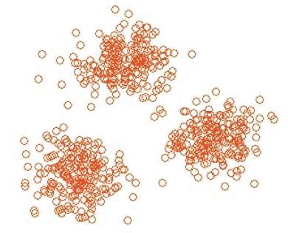
Sampling + KDD
The interplay between sampling and data mining is not well understood
Need an understanding of how ML/DM algorithms are affected by sampling
E.g. how big a sample is needed to build an accurate classifier?
E.g. what sampling strategy optimizes cluster quality
Expect results to be method specific
I.e. “IPPS + k-means” rather than “sample + cluster”

Slide 39

Sampling and Privacy
Current focus on privacy-preserving data mining
Deliver promise of big data without sacrificing privacy?
Opportunity for sampling to be part of the solution
Naïve sampling provides “privacy in expectation”
Your data remains private if you aren’t included in the sample…
Intuition: uncertainty introduced by sampling contributes to privacy
This intuition can be formalized with different privacy models
Sampling can be analyzed in the context of differential privacy
Sampling alone does not provide differential privacy
But applying a DP method to sampled data does guarantee privacy
A tradeoff between sampling rate and privacy parameters
Sometimes, lower sampling rate improves overall accuracy

Slide 40




Advert: Now Hiring…
Nick Duffield, Texas A&M
Phds in big data, graph sampling
Graham Cormode, University of Warwick UK
Phds in big data summarization (graphs and matrices, funded by MSR)
Postdocs in privacy and data modeling (funded by EC, AT&T)

Slide 41
Sampling for Big Data
x₁₀
x’₁₀
x₉
x’₉
∅
x₈
x’₈
x₇
x’₆
0
1
x₆
x’₅
x₅
x’₄
x₄
x’₃
00
01
10
11
x₃
x’₂
x₂
000
001
010
011
100
101
110
111
x₁
x’₁
Graham Cormode, University of Warwick G.Cormode@warwick.ac.uk
Nick Duffield, Texas A&M University Nick.Duffield@gmail.com

